Slide 1
Sharetea SaaS System
Team X1
Hrudith, Jhanghir, Sudeep, Rahul S., Rahul G., Nicholas

Slide 2
AGENDA

Slide 3
Agenda
Member Introductions
Problem Statement
Tech Stack
Accessibility Features
Usability Reports
Project Management
Additional Thoughts

Slide 4
MEMBER INTRODUCTIONS

Slide 5
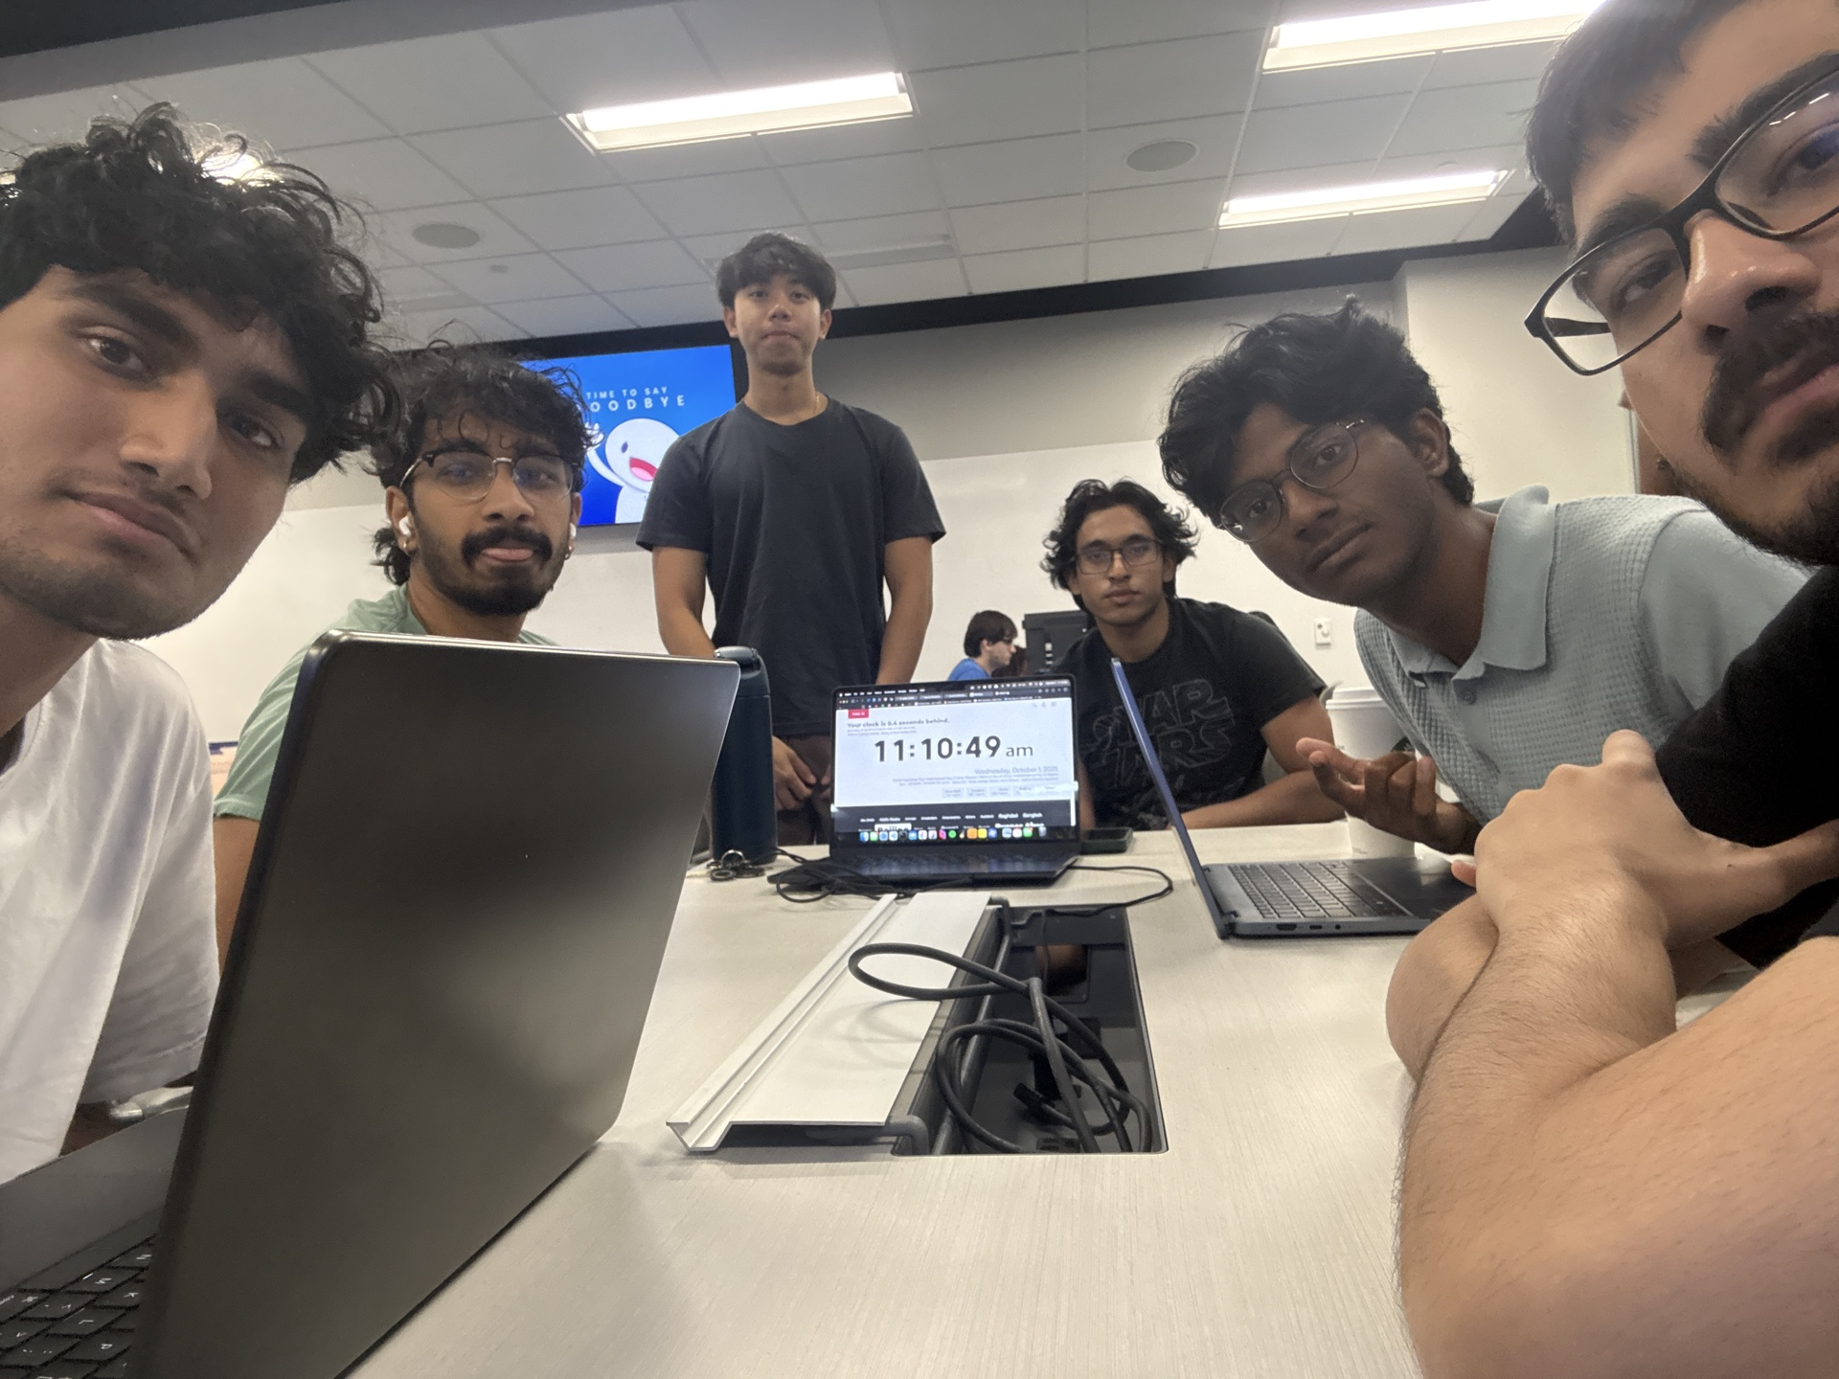
X1
Full Stack: Hrudith
Backend: Jhanghir
Backend: Sudeep
Frontend: Rahul S.
Database & API : Rahul G.
UI/UX & Testing: Nicholas
<Full Team Photo>

Slide 6

Full Stack: Hrudith
Dedicated Role Responsibilities
Full stack architecture design
Frontend/backend system integration
End-to-end feature implementation
Shared Role Responsibilities
Code reviews and collaboration
Bug fixes and troubleshooting

Slide 7
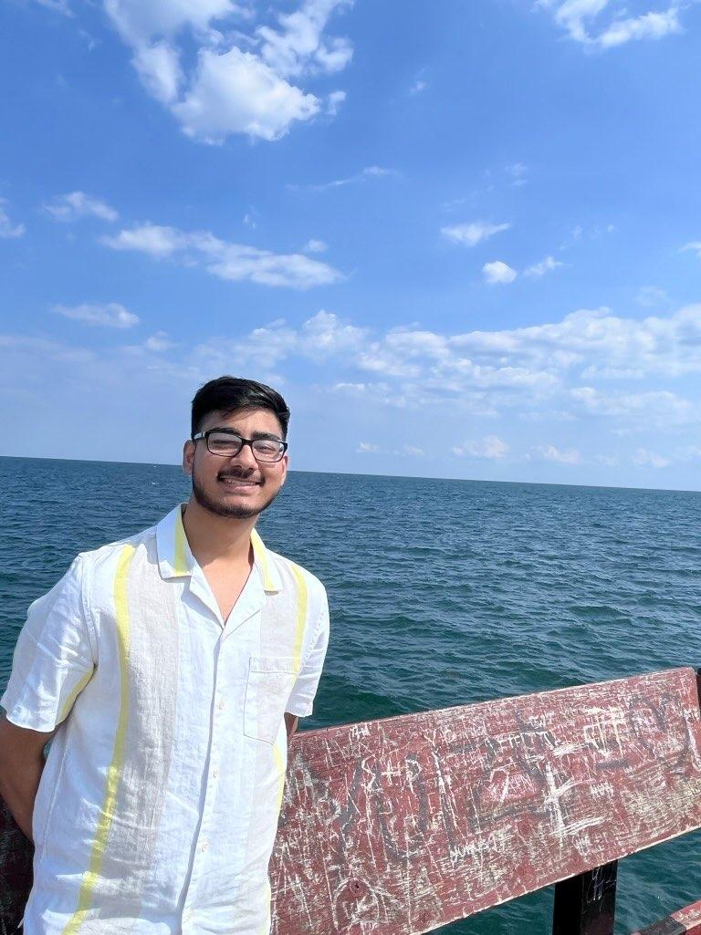
Backend: Jhanghir
Dedicated Role Responsibilities
PostgreSQL database development
Database schema and migrations
Authentication and authorization
Shared Role Responsibilities
Backend Database and API Testing
Bug fixes and troubleshooting

Slide 8

Backend: Sudeep
Dedicated Role Responsibilities
API endpoint development
Order and payment systems
Inventory management logic
Shared Role Responsibilities
Code reviews and collaboration
Database management and testing

Slide 9
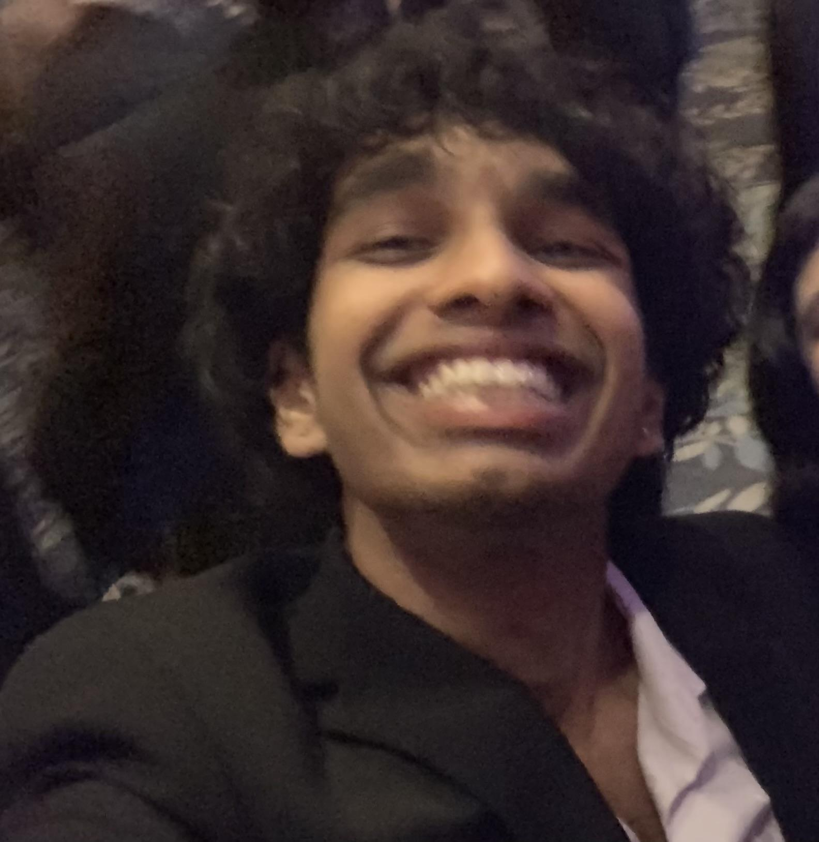
Frontend: Rahul S.
Dedicated Role Responsibilities
React component development
UI implementation with Tailwind
State management with Zustand
Shared Role Responsibilities
Backend Code reviews
UI development

Slide 10
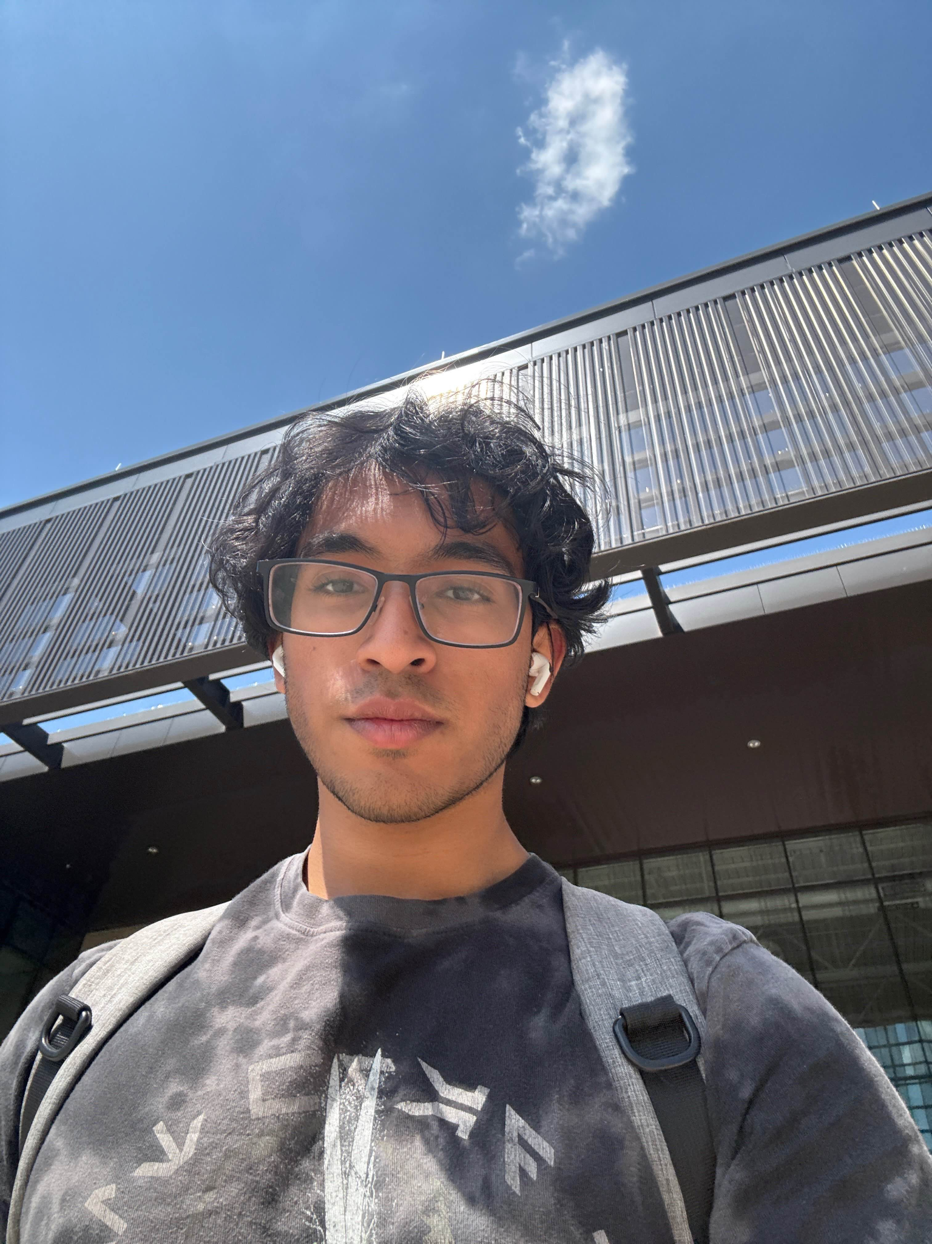
Database & API: Rahul G.
Dedicated Role Responsibilities
PostgreSQL database administration
SQL optimization and queries
Data migration scripts
Shared Role Responsibilities
Frontend code reviews
Bug fixes and troubleshooting

Slide 11
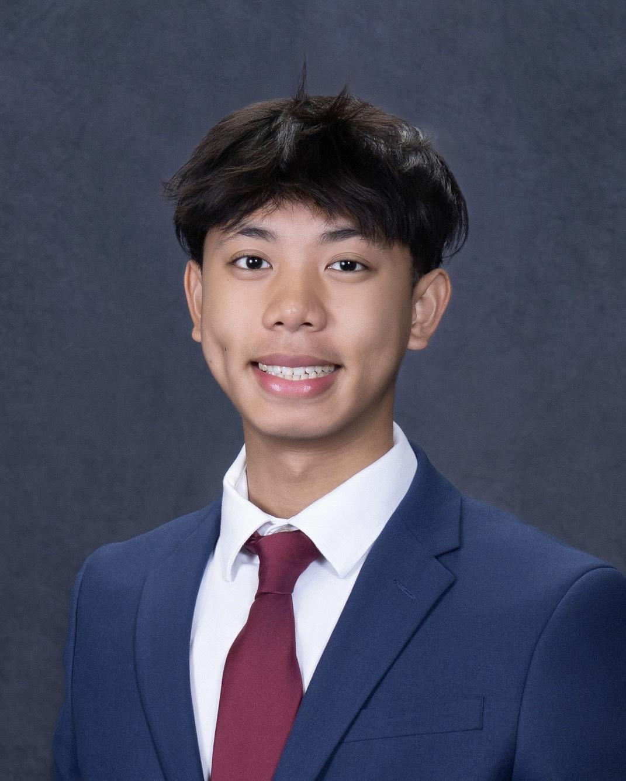
UI/UX & Testing: Nicholas
Dedicated Role Responsibilities
User interface design
Usability and accessibility testing
User feedback analysis
Shared Role Responsibilities
Database management
Bug fixes and troubleshooting

Slide 12
PROBLEM STATEMENT

Slide 13
Product Idea
Comprehensive SaaS solution for Sharetea franchise operations
Modern point-of-sale system replacing outdated legacy systems
Multi-role support: Manager, Cashier, Barista, Customer
Real-time order processing and kitchen display system
Inventory management with automatic alerts
Analytics and reporting dashboard

Slide 14
Project Details
Full-stack web application with role-based dashboards
Google OAuth 2.0 authentication system
PostgreSQL database with normalized schema
RESTful API architecture
Real-time updates for kitchen operations
Weather-based menu recommendations using AI

Slide 15
State-of-the-Art
Cloud-based deployment (Supabase + Vercel)
WCAG 2.1 AA accessibility compliance
Multilingual support (Google Translate API)
AI-powered features for enhanced customer experience
Responsive design for multiple device types

Slide 16
TECH STACK

Slide 17



Frontend Development
React 18 with Vite build system
React Router 6 for navigation
Zustand for state management
Tailwind CSS for styling
Vitest + React Testing Library

Slide 18



Backend Development
Node.js with Express framework
PostgreSQL 14+ database
Passport.js for authentication
JWT token-based authorization
Bcrypt for password hashing
Postman for API testing

Slide 19

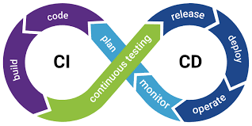
Full Stack Development
Monorepo architecture with npm workspaces
RESTful API design principles
Role-based access control (RBAC)
CORS-enabled cross-origin requests
Environment-based configuration
CI/CD ready deployment structure

Slide 20
ACCESSIBILITY FEATURES

Slide 21

1st Persona: Maria
Community health worker
Her mobile phone is her first computer
Uses computer translations
Needs clearly written information
Spanish/English bilingual

Slide 22



Accessibility Features for Maria
English/Spanish language toggle available
Google Translate widget embedded
Mobile-responsive design for phones
Clear labels in both languages
Simple, consistent navigation patterns
Semantic HTML structure throughout
Form fields with bilingual support

Slide 23

2nd Persona: Vishnu
Engineer, working on medical technology
World citizen through technology
Low vision due to glaucoma
Uses screen magnifiers
Contrast adjustment

Slide 24



Accessibility Features for Vishnu
Adjustable font size controls (A-/A/A+)
High contrast mode toggle available
ARIA labels for screen readers
Full keyboard navigation support
Clear focus indicators on elements
Real-time font size preview display
Semantic time elements with attributes

Slide 25

3rd Persona: Carol
Grandmother learning to use technology from grandkids
Macular degeneration causing tremors and limits reading capabilities
Has learned to enlarge text in browser

Slide 26
Accessibility Features for Carol
Large text up to 150%
High contrast theme reduces strain
Large touch targets for buttons
Skip navigation links for content
Clear visual hierarchy with spacing
Settings persist across browser sessions
Extra padding on interactive elements

Slide 27
USABILITY REPORTS

Slide 28
Lo-fi Prototyping
Initial sketches for user flows
Paper prototypes for menu navigation
Basic POS interaction wireframes
Customer kiosk layout concepts
Manager dashboard structure planning
Early accessibility feature considerations
Rapid iteration without coding

Slide 29
Hi-fi Wireframes
Figma designs for all interfaces
Complete component library created
Detailed POS cashier screen
Customer kiosk ordering flow
Manager dashboard with analytics
Accessibility controls panel design
Responsive layouts for mobile

Slide 30
User Study Feedback
Conducted accessibility-focused user testing
Three personas tested all flows
High-contrast mode validated positively
Language toggle worked effectively
Font size controls well-received
Navigation found clear and intuitive
Minor improvements identified and implemented

Slide 31
PROJECT MANAGEMENT

Slide 32
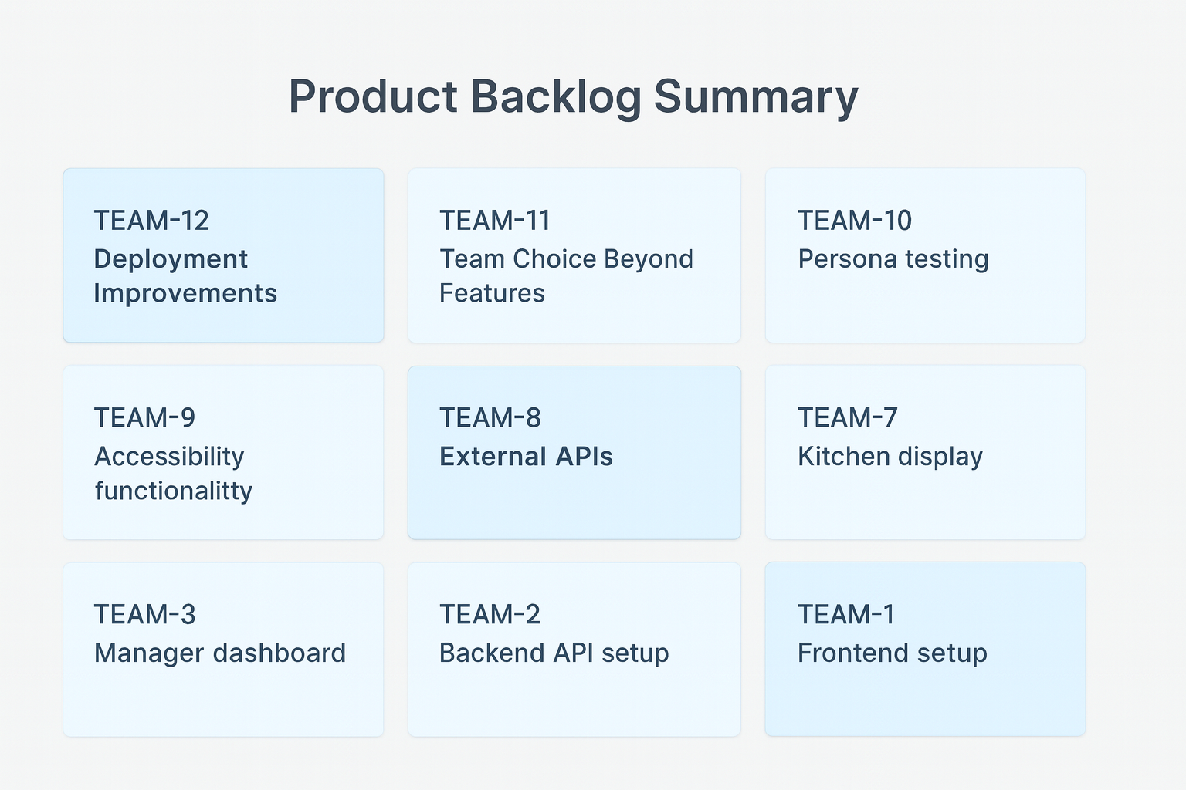
Product Backlog Summary
Total: ~200 story points created
Completed: 121 points
Sprint 1: 58 points
Sprint 2: 63 points
Remaining: ~80 points
Status: On track

Slide 33
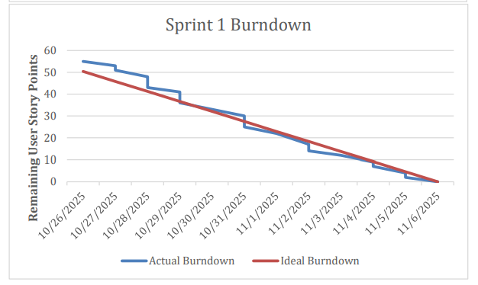
Sprint 1 Status
Duration: Oct 26 - Nov 16
Points completed: 58 total
Velocity: 29 points/week
Tasks: 23 items completed
Zero tasks deferred
Foundation successfully built

Slide 34
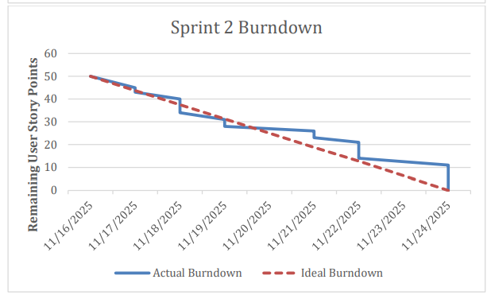
Sprint 2 Outlook
Duration: Nov 16 - Nov 24
Points completed: 63 total
Velocity: 31.5 points/week
Improvement: 8.6% over Sprint 1
All APIs integrated
UI features delivered

Slide 35
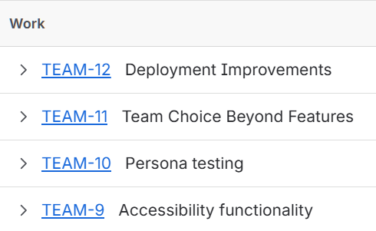
Sprint 3 Outlook
Duration: Nov 24 - Dec 7
Target: 65-70 story points
Focus: Testing and deployment
Regression testing all features
Final UI polish
Production deployment ready

Slide 36

Overall Project Outlook
Progress: 61% complete (121/200 points)
Velocity: Steadily increasing
Critical features: On schedule
Accessibility: Close to completion
Deployment: Sprint 3 target
Demo date: December 7

Slide 37
ADDITIONAL THOUGHTS

Slide 38
Questions
Best practices for production OAuth callback URLs?
Recommendations for database migration strategies?
Suggestions for load testing approach?
Guidance on API rate limiting implementation?
Feedback on our accessibility approach?

Slide 39
Concerns
Managing environment variables across platforms
Database connection security in cloud environment
OAuth flow testing in production
Performance under expected load

